Slide 1
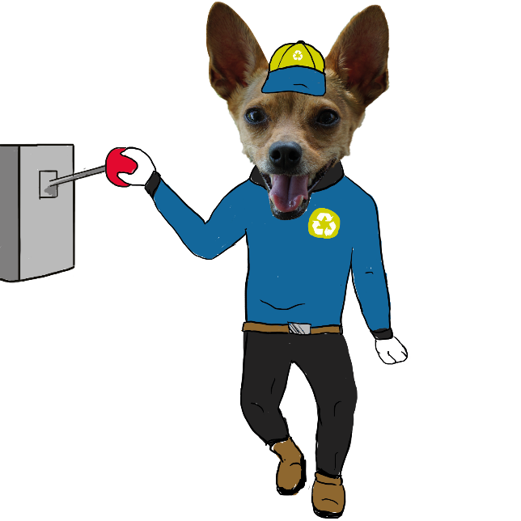
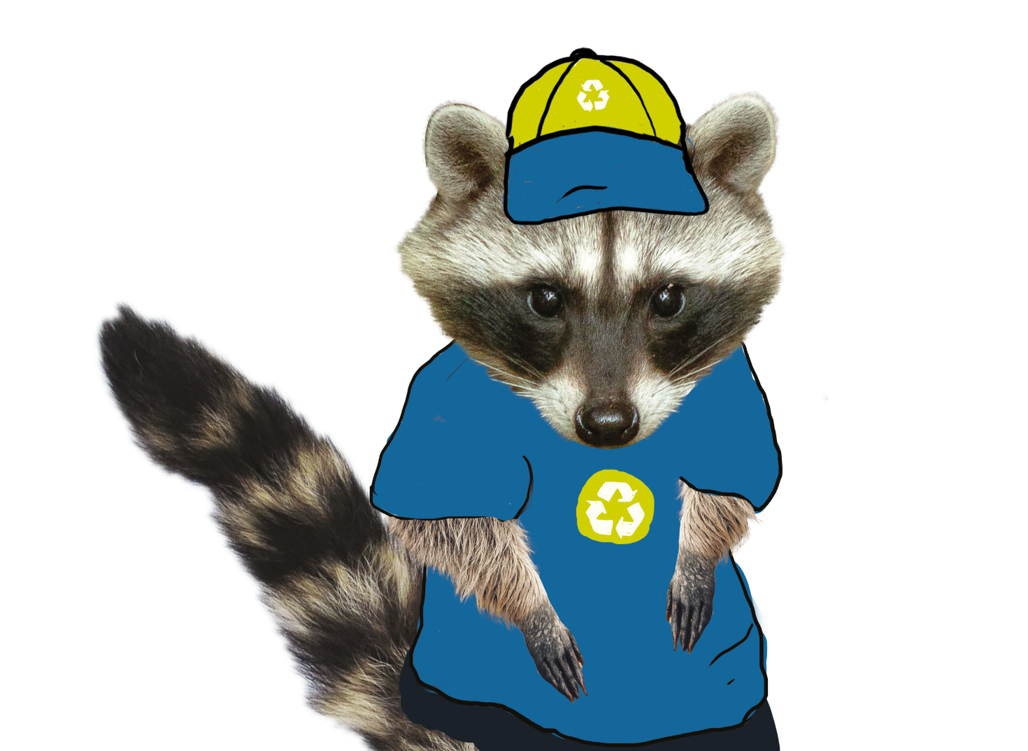
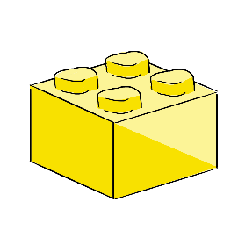
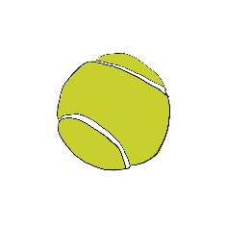
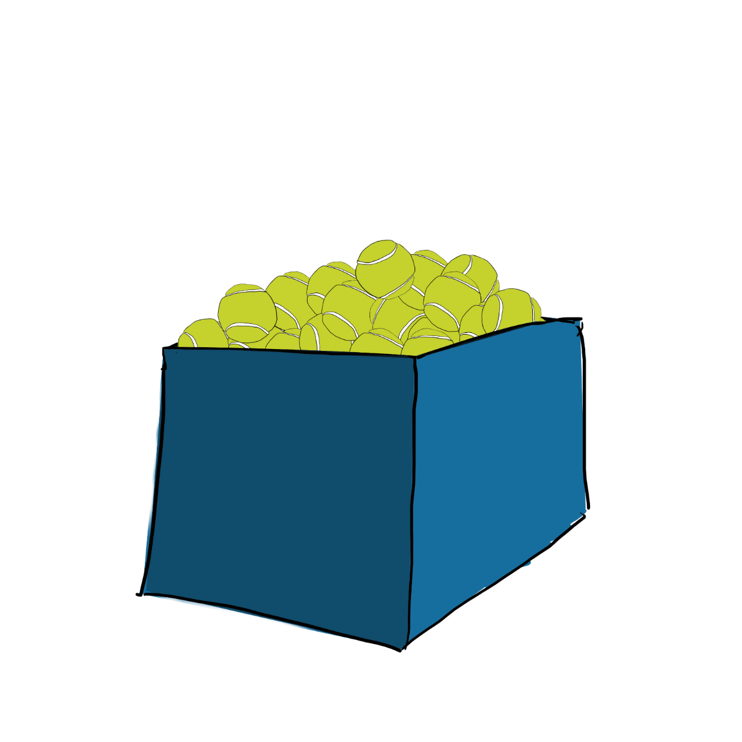
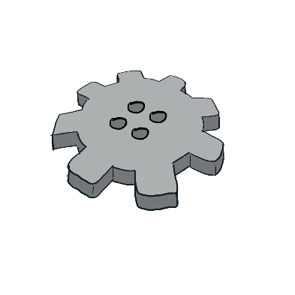
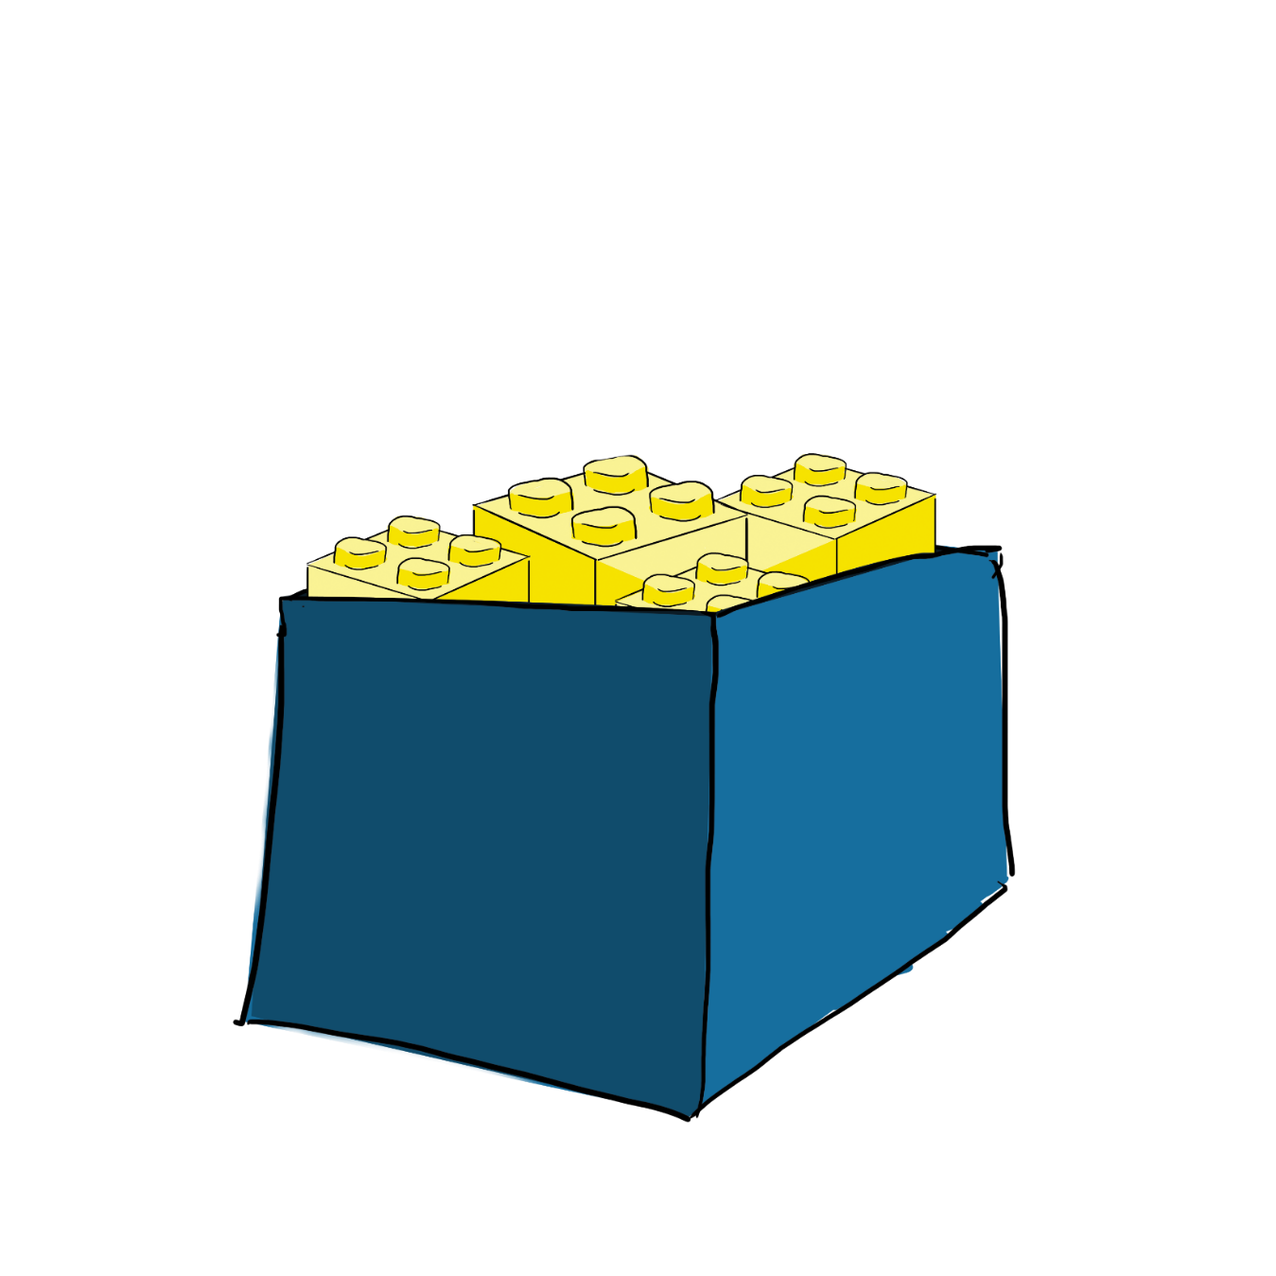

Slide 2
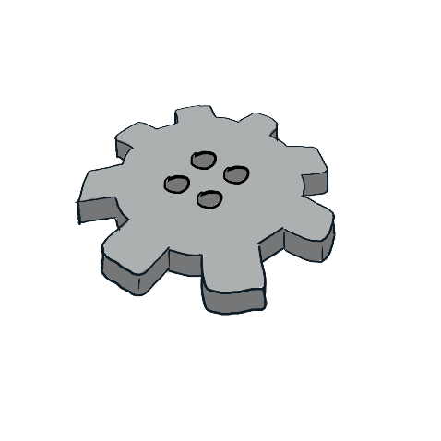
Setting the stage
The Challenge
We are asking you to design and build a new prototype that will sort different materials!
The truck that picks up the sorted materials will arrive tomorrow morning!
The piece is irreparable!
It’s urgent! There’s no time to waste!
An essential piece of the city’s main sorting machine broke down last night!

Slide 3
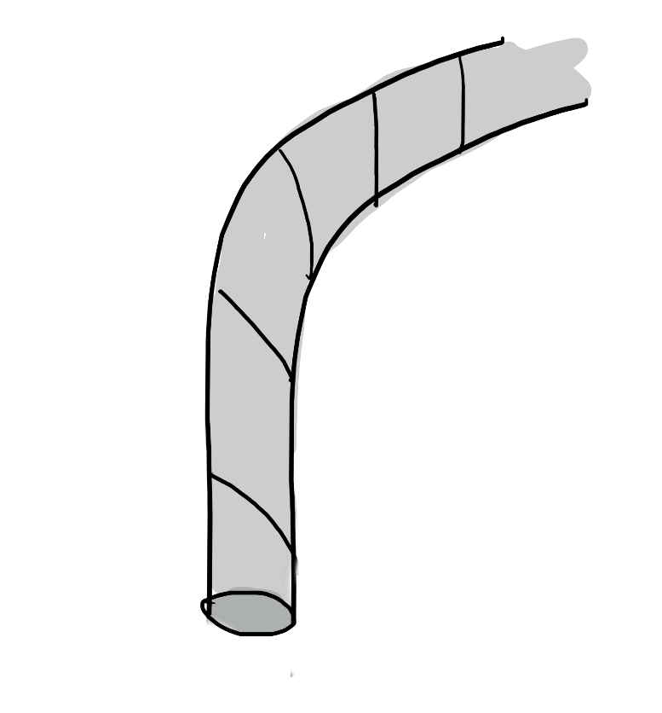
Setting the stage
The Challenge
By choosing materials from the list of permitted materials, design and produce a prototype that allows you to sort different types of objects and distribute them into assigned recovery containers.

Slide 4
Setting the stage
The Challenge
Each objet that is sorted correctly is worth 100 points.
Cycle 1
5 macaronis
5 marbles
5 ping pong balls
Cycle 2
5 marbles
5 centicubes
5 metal washers ½’’ (12,7 mm inside diameter and 34,93 mm outside diameter)
Cycle 3
10 marbles
10 centicubes
10 metal washers ½’’ (12,7 mm inside diameter and 34,93 mm outside diameter)

Slide 5
Activity 1

Slide 6
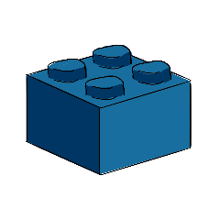
Activity 1
Strategic Sorting
1
Source : https://www.youtube.com/watch?v=8AFQ-CHPNKY

Slide 7
Activity 1
Strategic Sorting
What is this machine used for?
How does it separate (sort) objects?
1
Source : https://www.youtube.com/watch?v=8AFQ-CHPNKY

Slide 8
Activity 1
Strategic Sorting
2
Source : https://www.youtube.com/watch?v=_k_gkeIQtts

Slide 9
Activity 1
Strategic Sorting
What is this machine used for?
How does it separate (sort) objects?
2
Source : https://www.youtube.com/watch?v=_k_gkeIQtts

Slide 10
Activity 1
Strategic Sorting
3
Source : https://www.youtube.com/watch?v=Do_BPfDt1nI

Slide 11
Activity 1
Strategic Sorting
What is this machine used for?
How does it separate (sort) objects?
3
Source : https://www.youtube.com/watch?v=Do_BPfDt1nI

Slide 12
Activity 1
Strategic Sorting
4
Source : https://www.youtube.com/watch?v=ya9zTstjOIU

Slide 13
Activity 1
Strategic Sorting
What is this machine used for?
How does it separate (sort) objects?
4
Source : https://www.youtube.com/watch?v=ya9zTstjOIU

Slide 14
Activity 1
Strategic Sorting
5
Source : https://www.youtube.com/watch?v=-HiJHaPqblM

Slide 15
Activity 1
Strategic Sorting
What is this machine used for?
How does it separate (sort) objects?
5
Source : https://www.youtube.com/watch?v=-HiJHaPqblM

Slide 16
Activity 2

Slide 17
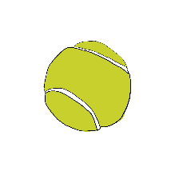
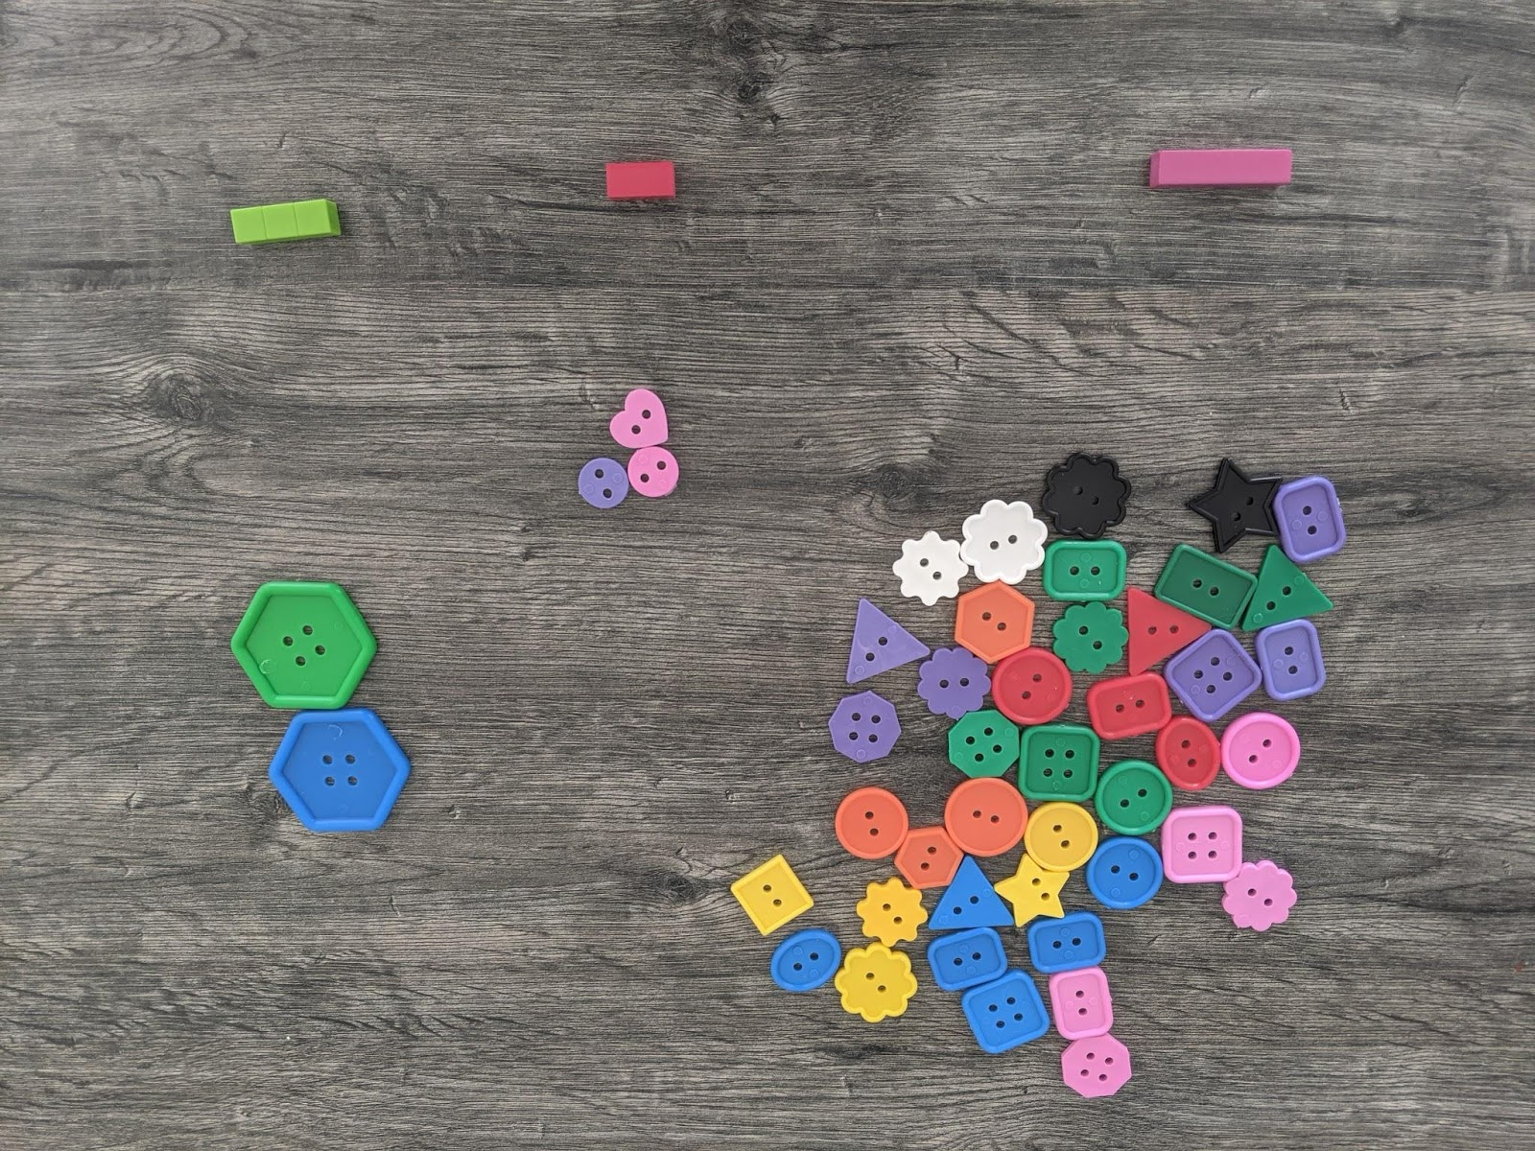
Activity 2 – Part A
Birds of a Feather…!
What is the sorting criterion used?
Which categories are used?

Slide 18
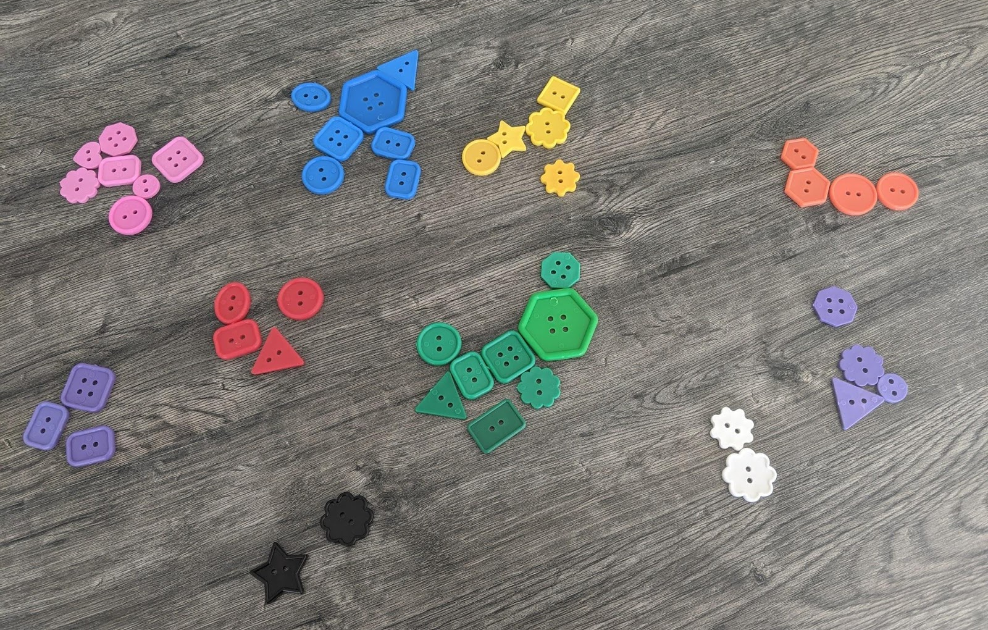
Activity 2 – Part A
Birds of a Feather…!
What is the sorting criterion used ?
Which categories are used?

Slide 19
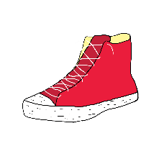
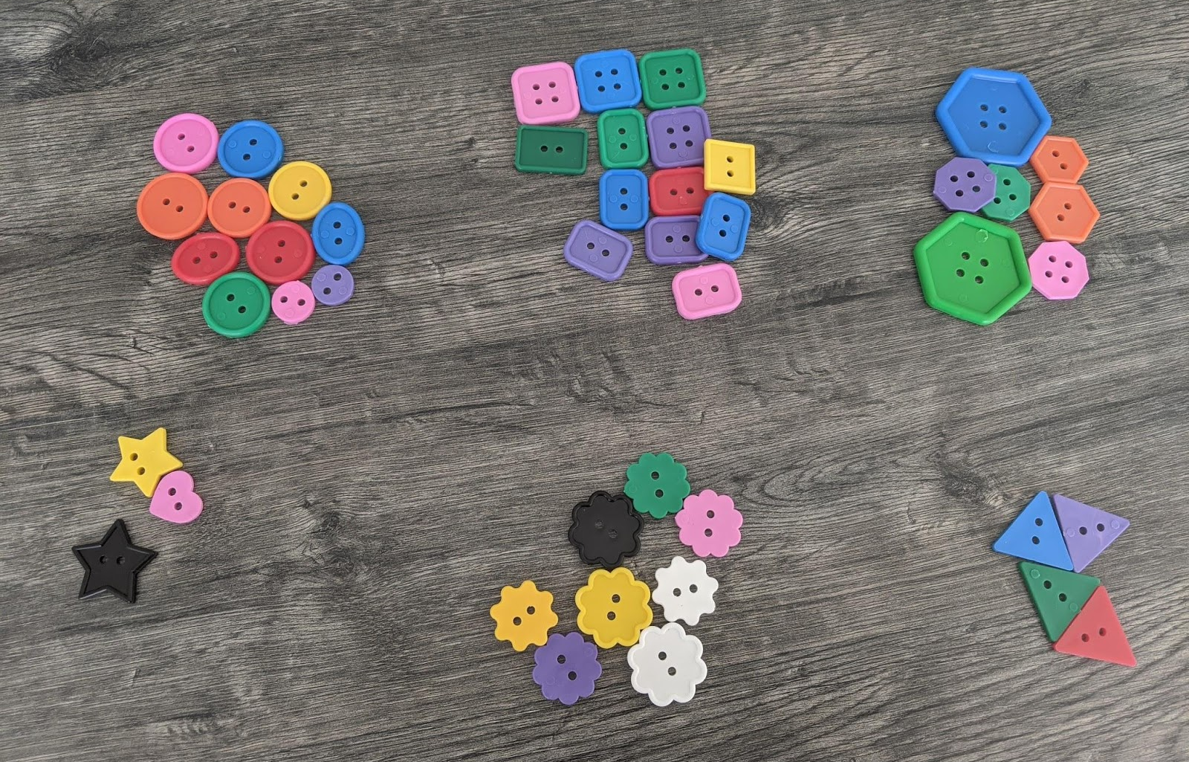
Activity 2 – Part A
Birds of a Feather…!
What is the sorting criterion used ?
Which categories are used?

Slide 20
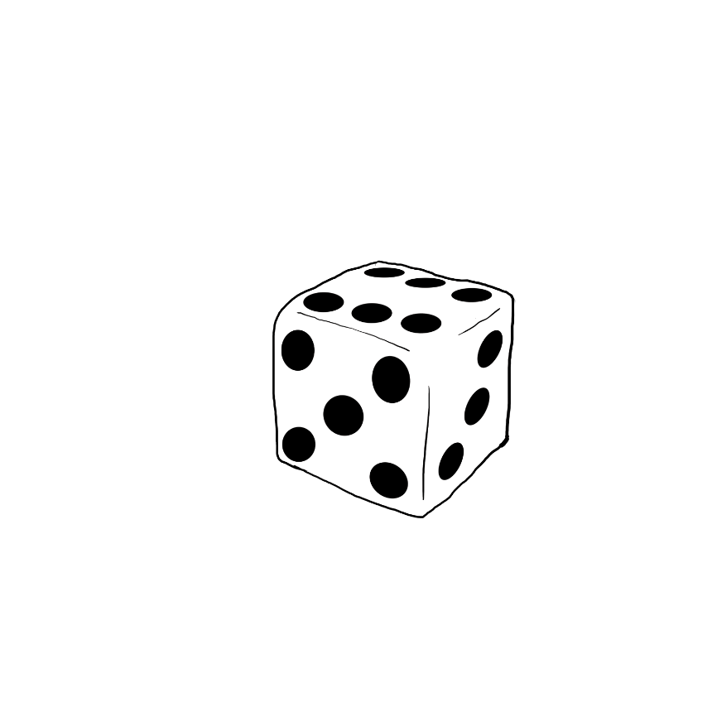
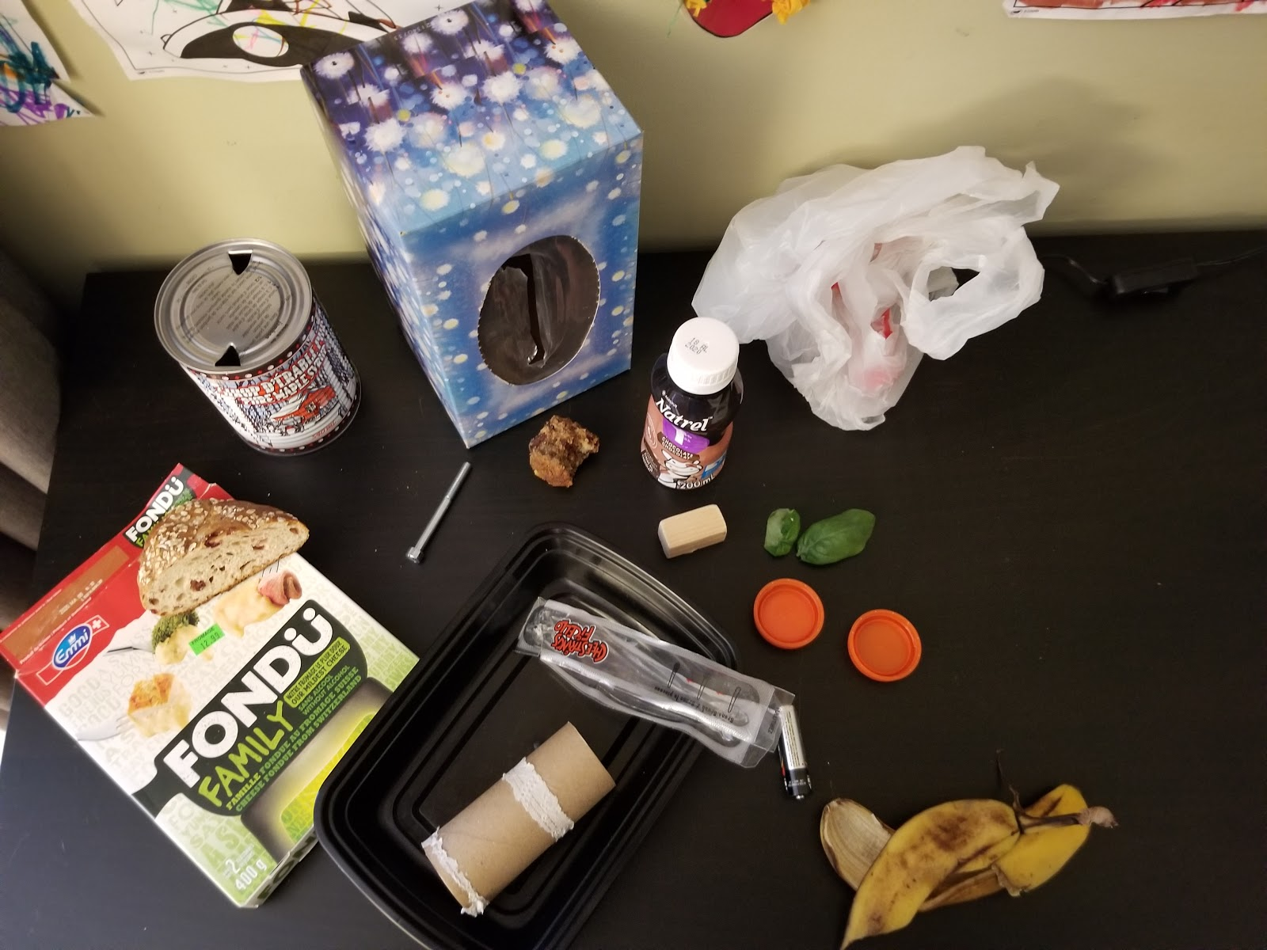
Activity 2 – Part A
Birds of a Feather…!
What could the sorting criterion be?
Which categories can be used to sort these objects?

Slide 21
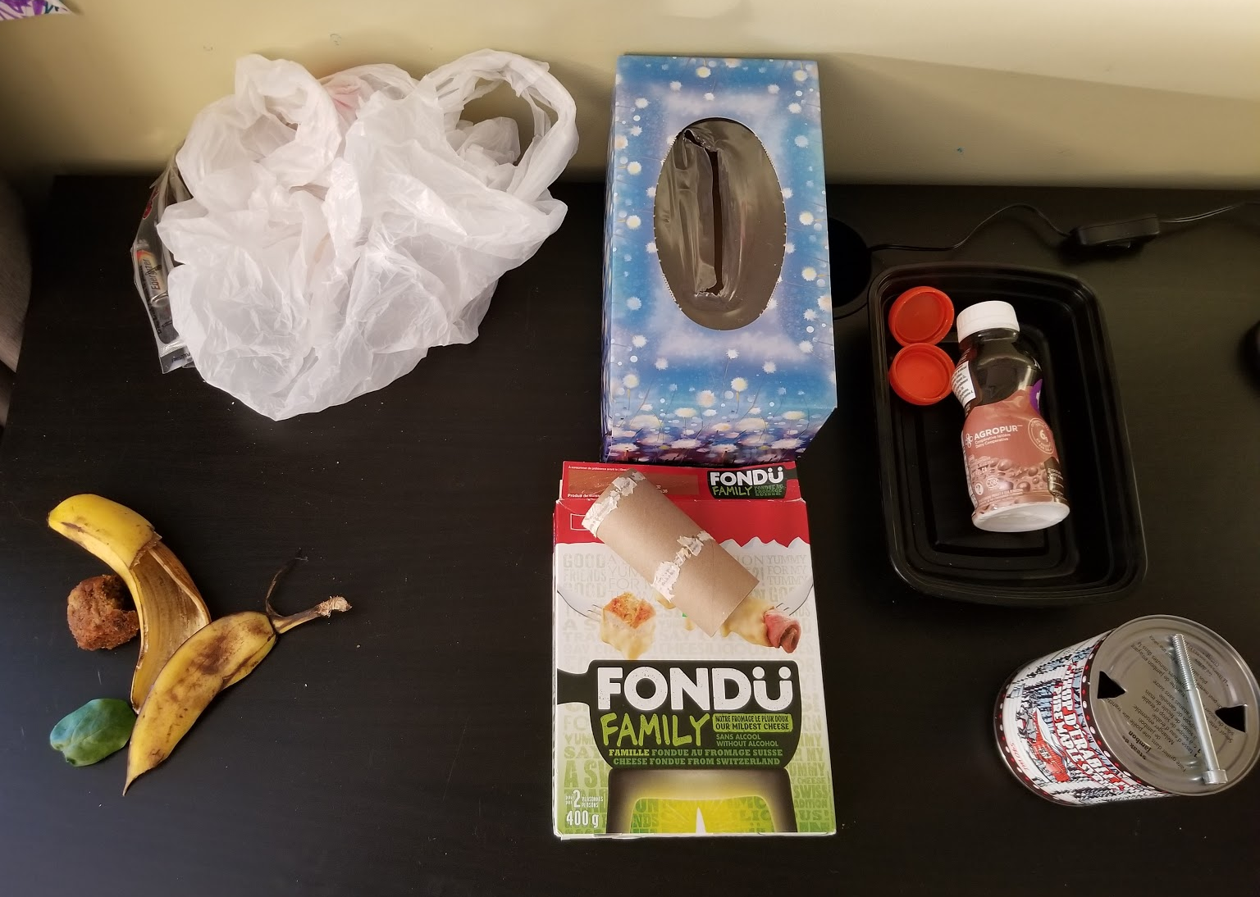
Activity 2 – Part A
Birds of a Feather…!
Non-recyclable plastics
Compostable (biodegradable) materials
Recyclable plastics
Metals
Materials destined for the sorting center

Slide 22
Activity 2 – Part A
Birds of a Feather…!
Source : https://www.youtube.com/watch?v=XvkZa6pr0QE
What is the criterion used to sort the LEGO?
What are the limitations of using this criterion?

Slide 23
Activity 2 – Part B
Birds of a Feather…!
Let’s exchange bags and criteria!
Are the results the same?
Are the results different?
Which objects were sorted differently?
Were your categories clearly defined?

Slide 24
Activity 3

Slide 25
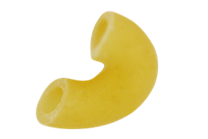
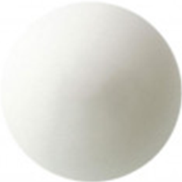
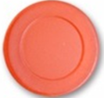
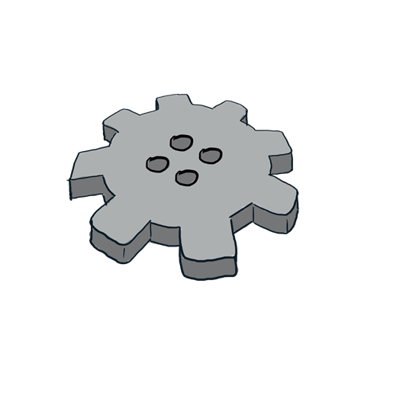
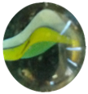
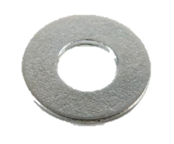
Activity 3 – Part A
Let’s Make an Impression!
What impressions will these objects leave in plasticine?

Slide 26
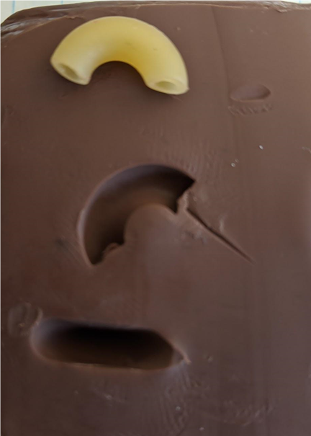
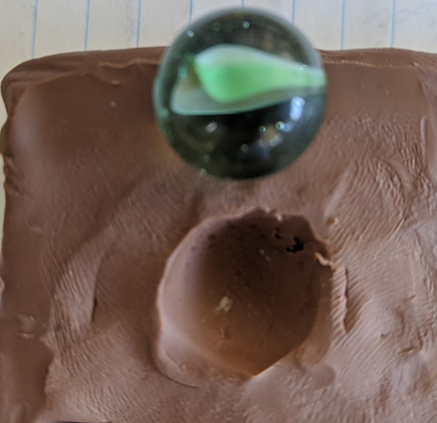
Activity 3 – Part A
Let’s Make an Impression!
Examples of impressions

Slide 27
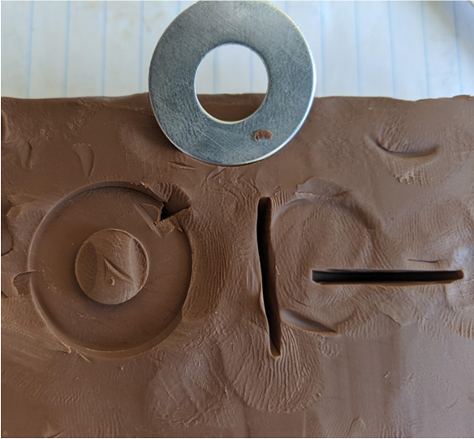
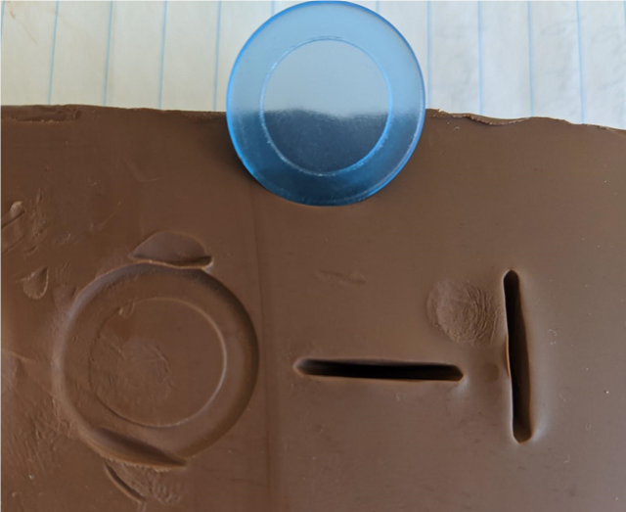
Activity 3 – Part A
Let’s Make an Impression!
Are there any impressions that look the same?

Slide 28
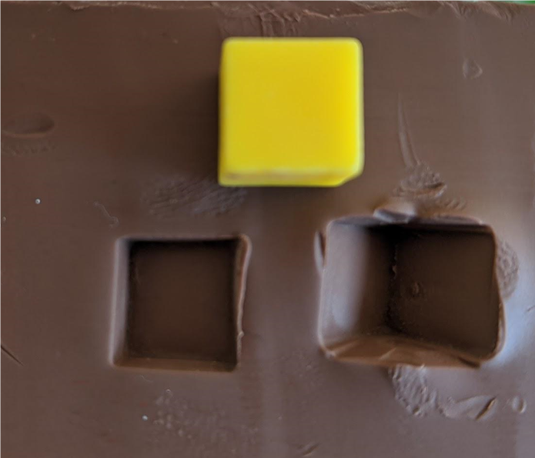
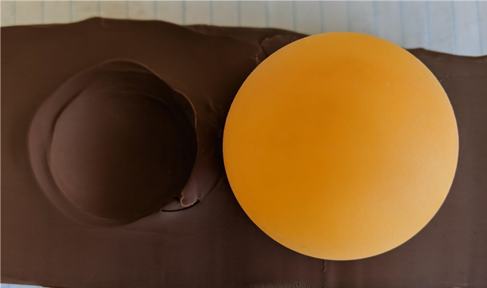
Activity 3 – Part A
Let’s Make an Impression!
Why is it important to recognize the different impressions that are left by the objects to be sorted?

Slide 29
Activity 4

Slide 30
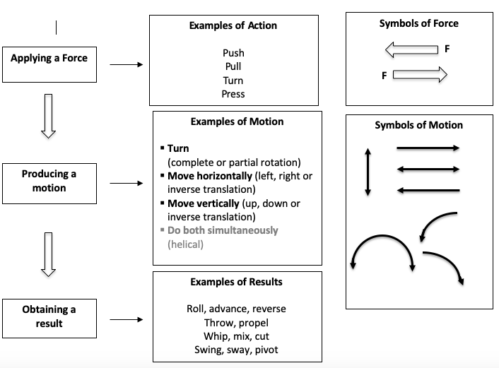
Activity 4 – Part A
Push, Pull, Turn!
Force and Motion

Slide 31
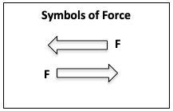
Activity 4 – Part A
Push, Pull, Turn!
Applying Force
I must apply a force to a technological object to set it in motion.
When I apply a force to an object, it can produce several results. We will focus on two of them.
When I push: the result is compression.
When I pull: the result is traction.

Slide 32
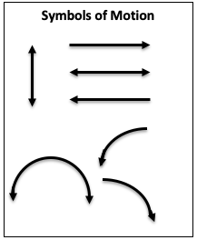
Activity 4 – Part A
Push, Pull, Turn !
Motion
A force applied creates a motion.
A force applied to the movable parts of a technical object can result in three different types of motion:
- rotation
- translation
- helical motion*

Slide 33
Activity 4 – Part A
Push, Pull, Turn!
Some inspiration…
Decide which kind of motion the following objects represent: translation or rotation.
In your student handbook, draw an arrow that represents:
where the force must be applied to displace the movable part;
the resulting motion.

Slide 34
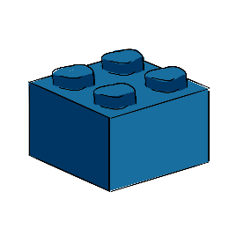
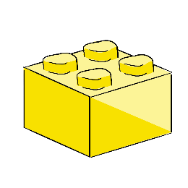
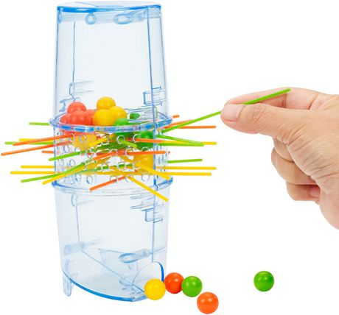
Activity 4 – Part A
Push, Pull, Turn!
Indicate whether the movable part makes a translational or a rotational motion.
In your student handbook, draw an arrow that represents: where the force must be applied to displace the movable part; the resulting motion.
Identify the type of motion…
Rotation or translation ?

Slide 35
Activity 4 – Part A
Push, Pull, Turn!
Indicate whether the movable part makes a translational or a rotational motion.
In your student handbook, draw an arrow that represents: where the force must be applied to displace the movable part; the resulting motion.
Identify the type of motion …
Rotation or translation ?

Slide 36
Activity 4 – Part A
Push, Pull, Turn!
Indicate whether the movable part makes a translational or a rotational motion.
In your student handbook, draw an arrow that represents: where the force must be applied to displace the movable part; the resulting motion.
Identify the type of motion …
Rotation or translation ?

Slide 37
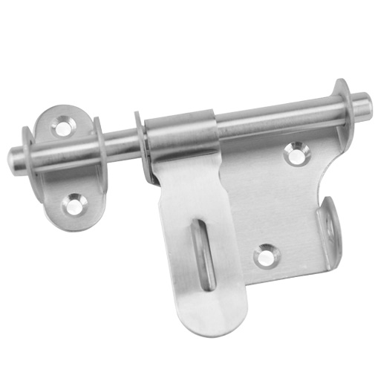
Activity 4 – Part A
Push, Pull, Turn!
Indicate whether the movable part makes a translational or a rotational motion.
In your student handbook, draw an arrow that represents: where the force must be applied to displace the movable part; the resulting motion.
Identify the type of motion …
Rotation or translation ?

Slide 38
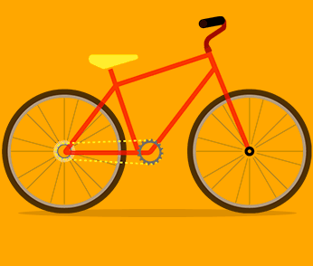
Activity 4 – Part A
Push, Pull, Turn!
Indicate whether the movable part makes a translational or a rotational motion.
In your student handbook, draw an arrow that represents: where the force must be applied to displace the movable part; the resulting motion.
Identify the type of motion …
Rotation or translation ?

Slide 39
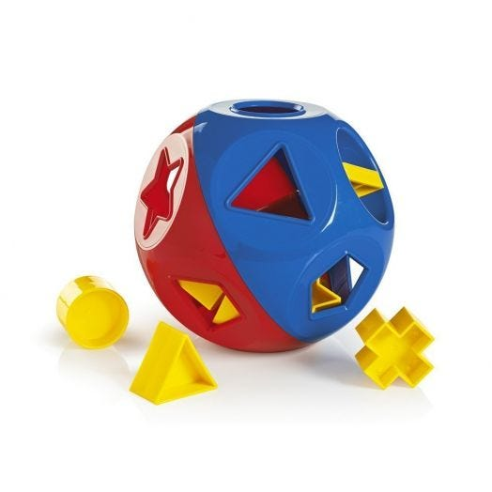
Activity 4 – Part A
Push, Pull, Turn!
Indicate whether the movable part makes a translational or a rotational motion.
In your student handbook, draw an arrow that represents: where the force must be applied to displace the movable part; the resulting motion.
Identify the type of motion …
Rotation or translation ?

Slide 40
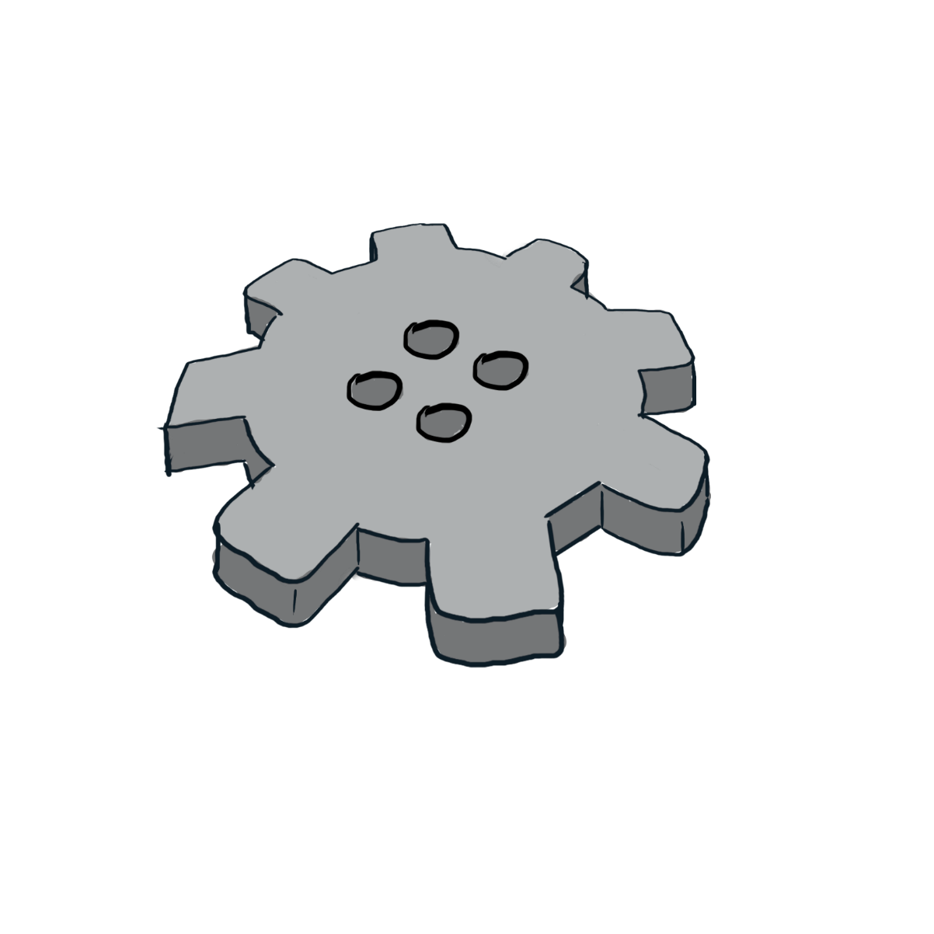
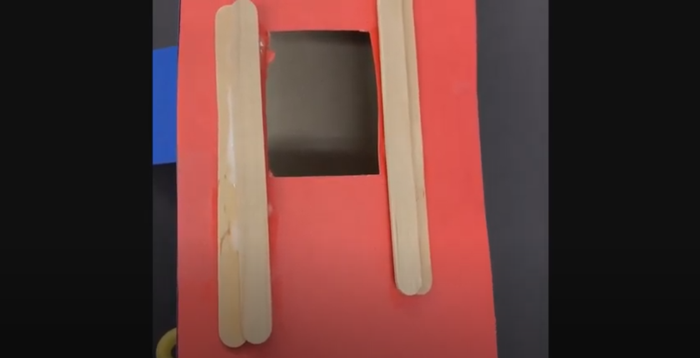
Activity 4 – Part B
Push, Pull, Turn!
Translation: With 4 popsicle sticks
Source : https://www.youtube.com/watch?v=CXBQ_81wfHo

Slide 41
Activity 4 – Part B
Push, Pull, Turn!
Translation: With 4 popsicle sticks
Since we can open the door by pushing on it or by pulling it, the force will not be applied at the same place. The motion will remain the same.

Slide 42
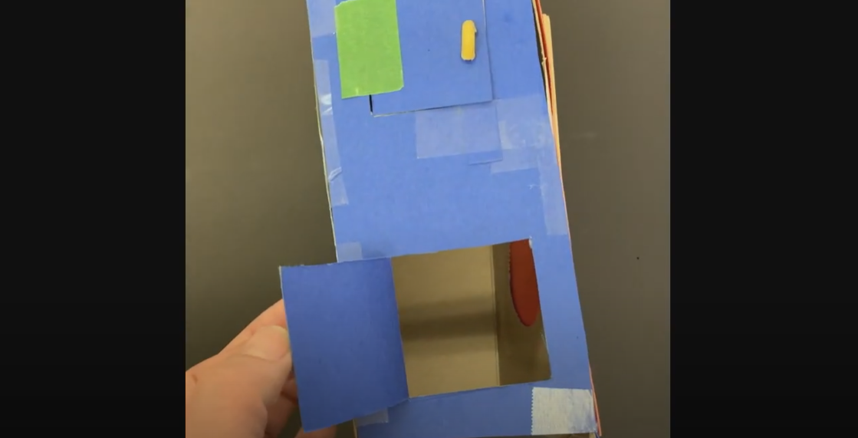
Activity 4 – Part B
Push, Pull, Turn!
Rotation : Three-sided cut-out (hinged door)
Source : https://www.youtube.com/watch?v=7iod7hyTrjQ

Slide 43
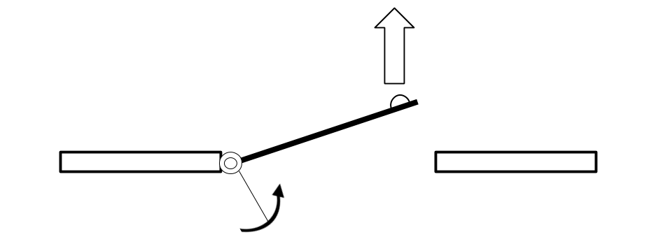
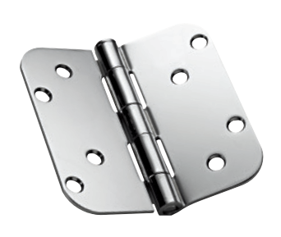
Activity 4 – Part B
Push, Pull, Turn!
Rotation : Three-sided cut-out (hinged door)
Since we can open the door by pushing on it or by pulling it, the force will not be applied at the same place. The motion will remain the same.

Slide 44
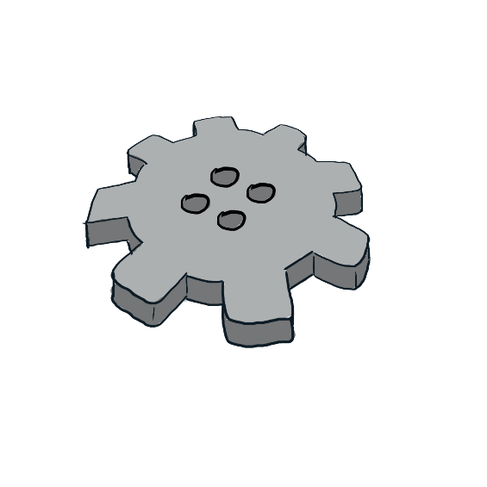
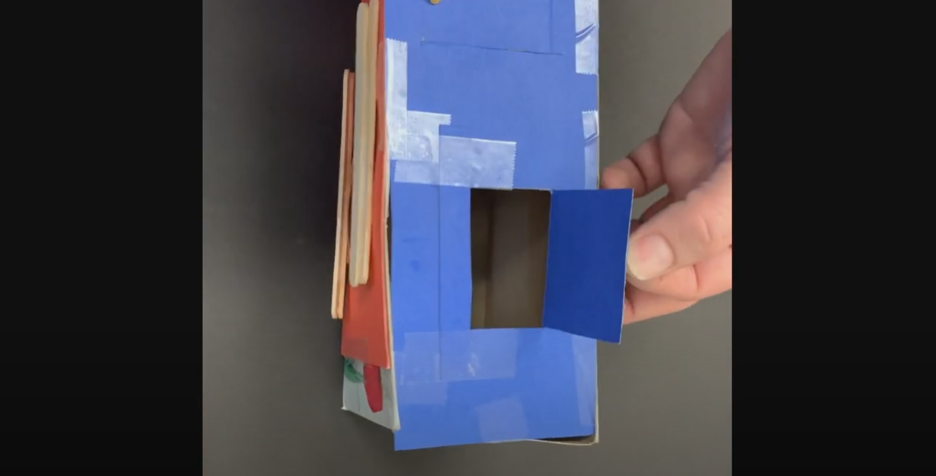
Activity 4 – Part B
Push, Pull, Turn!
Rotation : Four-sided cut-out (hinged door)
Source : https://www.youtube.com/watch?v=2ZZZr4jC9NA

Slide 45
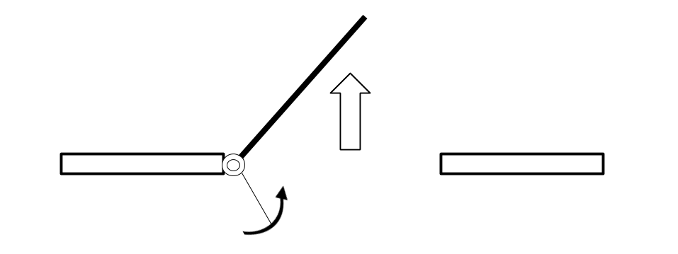
Activity 4 – Part B
Push, Pull, Turn!
Rotation : Four-sided cut-out (hinged door)
Since we can open the door by pushing on it or by pulling it, the force will not be applied at the same place. The motion will remain the same.

Slide 46
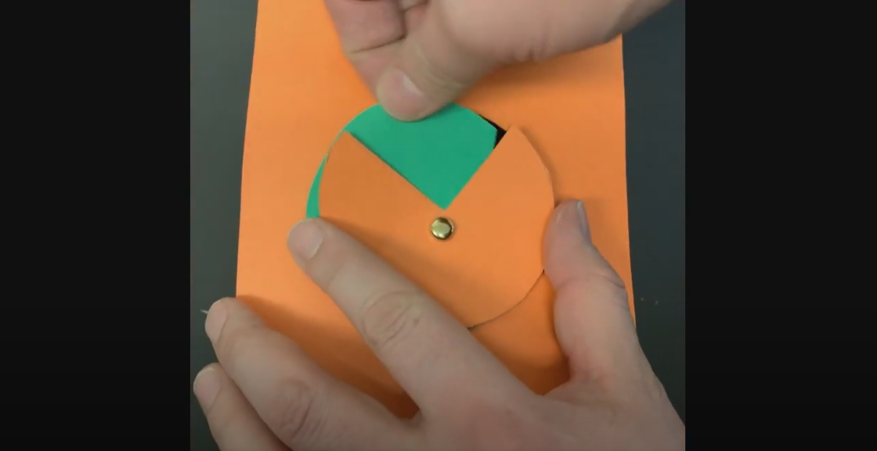
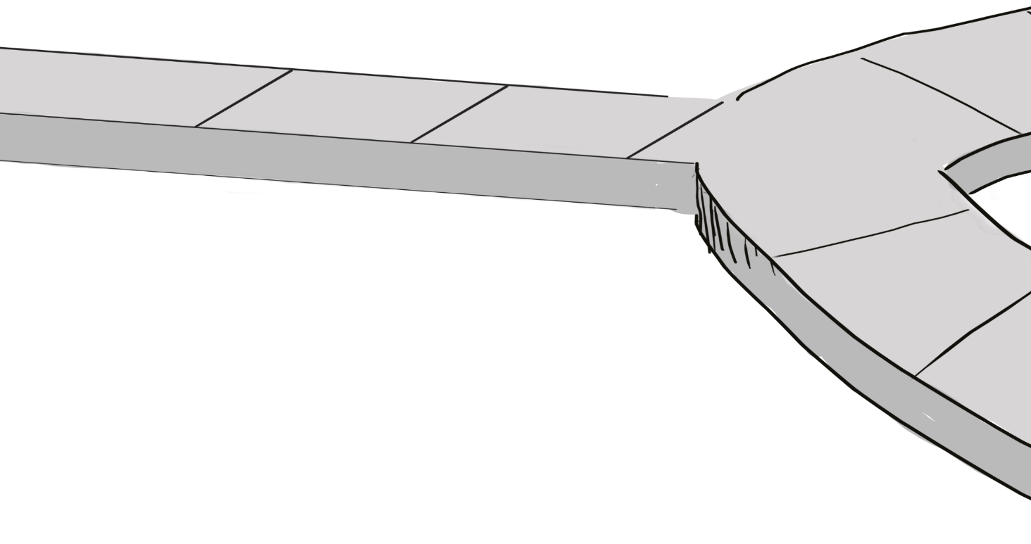
Activity 4 – Part B
Push, Pull, Turn!
Rotation: Circle with an opening (3/4)
Source : https://www.youtube.com/watch?v=eFgaSOU7zmg

Slide 47
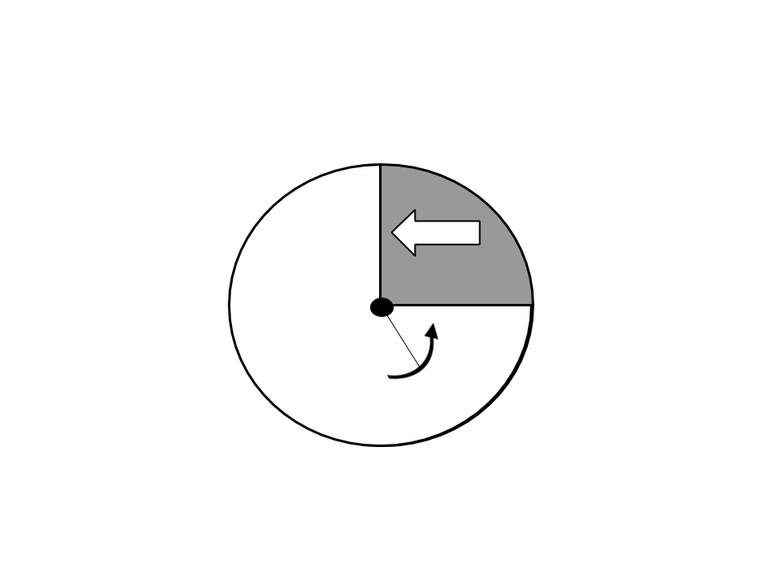
Activity 4 – Part B
Push, Pull, Turn!
Rotation: Circle with an opening (3/4)
Since we can open the door by pushing on it or by pulling it, the force will not be applied at the same place. The motion will remain the same.

Slide 48
Activity 4 – Part B
Push, Pull, Turn!
Translation: Brochette sticks
Source : https://www.youtube.com/watch?v=kYkhGmB3kes

Slide 49
Activity 4 – Part B
Push, Pull, Turn!
Translation: Popsicle sticks
Source : https://www.youtube.com/watch?v=-sDdIxHMXg8

Slide 50
Activity 4 – Part B
Push, Pull, Turn!
Translation: Brochette sticks or popsicle sticks
Since we can open the door by pushing on it or by pulling it, the force will not be applied at the same place. The motion will remain the same.

Slide 51
Activity 4 – Part B
Push, Pull, Turn!
What are the advantages
and the disadvantages
of each of the systems?

Slide 52
Activity 5

Slide 53
Activity 5 – Part A
The Laws of Attraction!
How will each object react to the magnet?
Attract (A)
Repel (R)
No reaction (X)

Slide 54
Preparing to Meet the Challenge

Slide 55
Preparing to Meet the Challenge
By choosing materials from the list of permitted materials, design and produce a prototype that allows you to sort different types of objects and distribute them into assigned recovery containers.

Slide 56
Preparing to Meet the Challenge
Cycle 1
Sort three different types of objects and distribute them in at least two assigned recovery containers. One of the types of objects can remain in the sorter.
Cycles 2 & 3
Sort three different types of objects and distribute them into three assigned recovery containers.

Slide 57
Preparing to Meet the Challenge
Each objet that is sorted correctly is worth 100 points.
Cycle 2
5 marbles
5 centicubes
5 metal washers ½’’ (12,7 mm inside diameter and 34,93 mm outside diameter)
Cycle 1
5 macaronis
5 marbles
5 ping pong balls
Cycle 3
10 marbles
10 centicubes
10 metal washers ½’’ (12,7 mm inside diameter and 34,93 mm outside diameter)

Slide 58
Preparing to Meet the Challenge
Rules – Construction
1.
The sorter should fit into a cardboard box designed to hold 5,000 letter-sized sheets of paper.
2.
The sorter must be made solely of materials that are on the list of permitted materials (see next slide).
3.
The sorter must have an opening that allows the teacher to easily place the objects in it.
4.
The sorted objects must be distributed in the designated recovery containers. The team can place the containers in any order they want.

Slide 59
Preparing to Meet the Challenge

Slide 60
Preparing to Meet the Challenge
Rules – Schedule of events
1.
The competition consists of two identical rounds. The best of the two rounds will be selected for ranking. In the event of a tie, the other round will be counted as well.
2.
Each team must designate an operator to manipulate the sorter throughout the sorting process.
3.
Only the teacher places the objects in the sorter.
4.
The stopwatch starts when the teacher places the objects in the sorter at the location indicated by the student.

Slide 61
Preparing to Meet the Challenge
Rules – Schedule of events
5.
The stopwatch stops when the student announces that the sorting is complete.
6.
During the sorting, it is forbidden to touch the objects to be sorted with your hands or with any other object.

Slide 62
Preparing to Meet the Challenge
Scoring
The team’s prototype must sort as many objects as possible in the shortest time possible.
Objects outside the recovery container will not be counted.
An object that is found in the wrong recovery container will not be counted.

Slide 63
Enjoy the challenge!

