Slide 1
Activity 1 – The Wheel Hunt

Slide 2
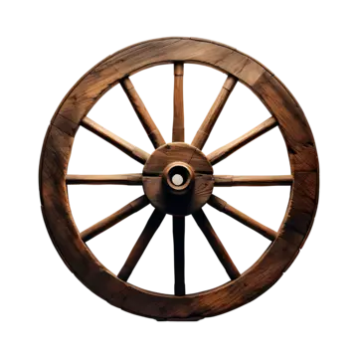
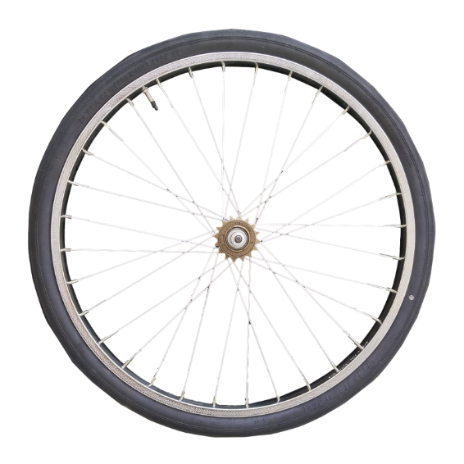
Let’s review your prior knowledge before we start!
The wheel is considered to be one of the ____________________ inventions.
?
most important
It revolutionized the way people work by making it possible to _____________ heavy materials.
?
transport
?
move
It also made it possible to ___________ around more easily.​

Slide 3
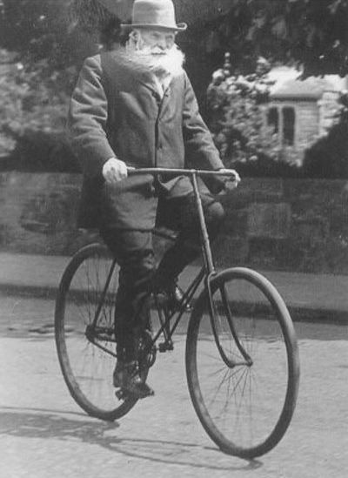
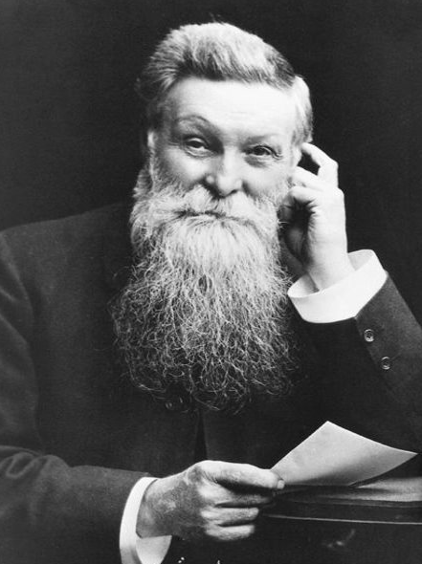
In 1888, John Dunlop obtained a patent for his invention: the rubber tire.
?
rubber
He took tubes made of ___________ and filled them with _____, then placed them around the wheels of his son's tricycle.
air
?
He had just invented the rubber tire!

Slide 4
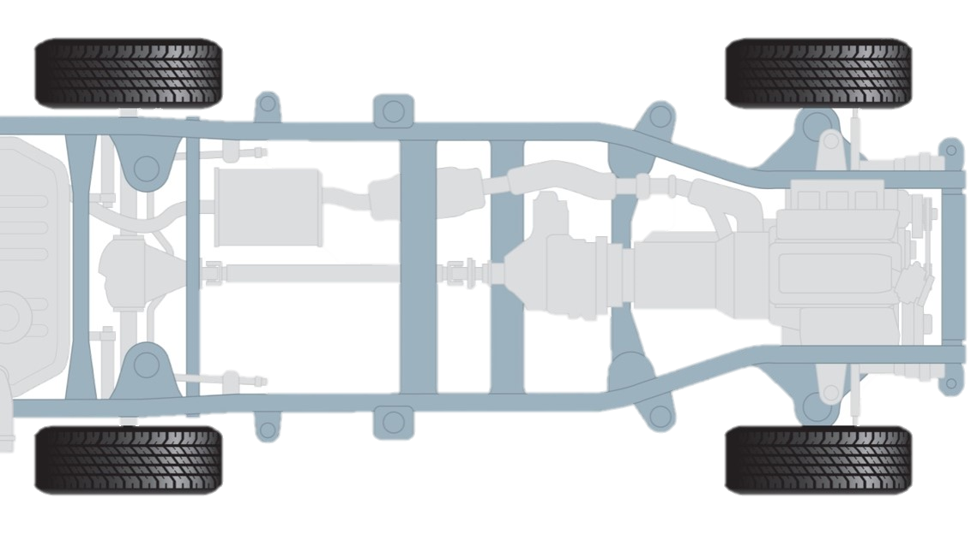
The wheel is a flat disc that rotates around its axis, passing through its center.
The axle is a rod which connects the wheels and allows them to rotate.
The chassis supports and secures the vehicle’s structure.
Remember to write your answers in your Student Handbook!

